Slide 1
Cornell Notes

Slide 3
In Summary
Repetitions are HUGE!
Cornell Notes are a great way to get up to 10 repetitions.
More quality repetitions = better grades.

Slide 4
Lesson #:
Lesson Title
Last Name, First
Date
Period
Learning Objective:______________________________
Essential Question:______________________________
Vocabulary Word
Defiinition/Category
& Descriptors
Example
2 1/2”
When vocabulary is complete, Draw a Line underneath and change the three headings to:
Questions, Notes, and Steps.

Slide 5
Lesson #:
Lesson Title
Last Name, First
Date
Period
Learning Objective:______________________________
Essential Question:______________________________
Questions
Notes
Steps:
2 1/2”
Questions (should be one per chunk or example)
Example 1: Title of Slide
a) b) c)
Example 2: Title
Class Notes
4 to 5 sentence summary across
the bottom of the last page of notes

Slide 6
Notes Rubric
# of Points
1
3
3
3
10 total
must have both LO & EQ
1 point per question
summary:
1 pt IVF format, 2 pts 4 or more sentences
marking up text
1 pt – chunk summary, 1pt – circle key words, 1 – pt underline main ideas
Points
1 both LO & EQ
1 each question (3 max)
3 summary:
1 pt IVF format, 2 pts 4 or more sentence
2 pts marking up text
1 sentence summary, circle key words, underline main ideas
10 total

Slide 7
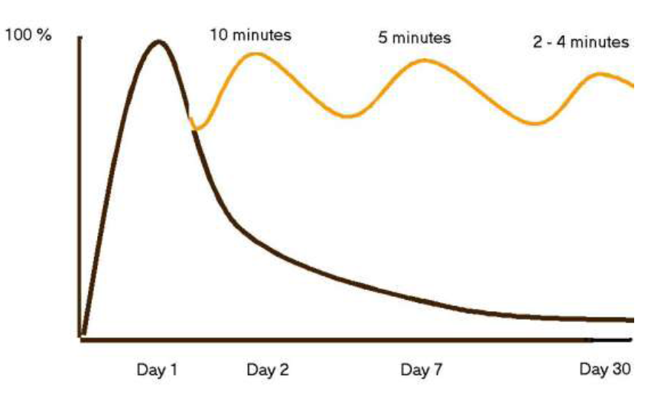
Curve of Forgetting
http://www.csub.edu/~bruff/The%20Forgetting%20Curve.pdf

Slide 8
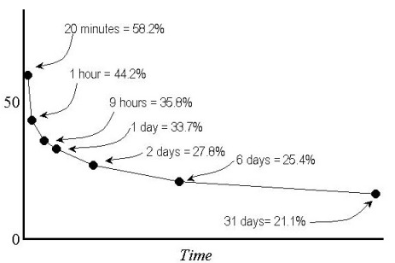
http://avidcollegeready.org/college-career-readiness/2011/1/19/why-do-i-have-to-take-notes-the-brain-note-connection.html

Slide 9
